Slide 1
ARchat
By: Team 5
(Akshar Belaguly, Medha Kappagantu, Dhara Panchal, Amelia Pagunsan, and Katelyn Mak)
Notes:
This is team 5’s project called ARchat.

Slide 2


Our Idea
ARchat would serve as a socializing platform that connected people with shared interests
We imagined that the process would be easy and efficient, as it would be held on the efficient AR medium, echoAR.
Notes:
Our idea was to make a socializing platform that connected people with shared interests through augmented reality which is also known as AR and created a platform called ARchat.

Slide 3

Our Goal
Our goal was to portray Bitmoji “friends,” or customized icons through Augmented Reality.
Our medium was a website that would include buttons that would redirect the user to different tabs featuring echoAR’s amazing AR technology, with the characters being “placed” into the real world.
We also wanted a chat feature to help people communicate with others easily.
Notes:
For those of you who don’t know (after first bullet point), Bitmoji is in app that helps you create your own avatar. It takes skin color, hair style, clothing, and many others to create the best person customization experience.

Slide 4
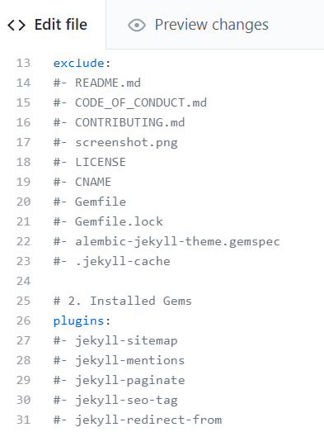
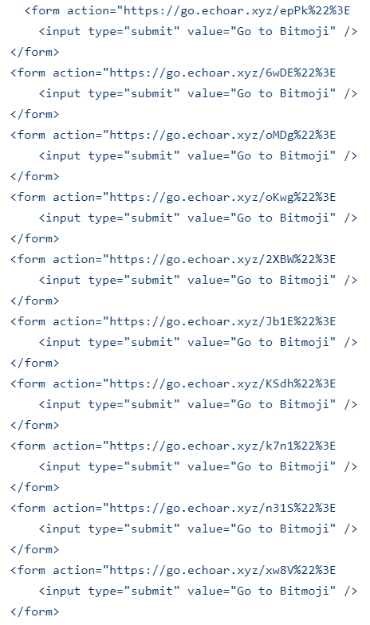
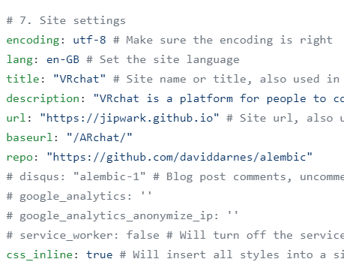
Version 1 | Version 2 | Version 3
Website text editing.
Commented everything.
Bitmoji Button Code.
Notes:
Akshar: For the second version of our program, we tried to incorporate buttons that would redirect the user to echoAR into our code, but it failed, so we had to scrap it and make a third version, which would be our final. Medha: For our 3rd iteration we tried again, and it worked this time. There was only problem, the title would not change. We left our website and decided to integrate the bitmoji portion, inside our chat feature. This succeeded, and we were able to present chatting and the AR bitmoji together.

Slide 5
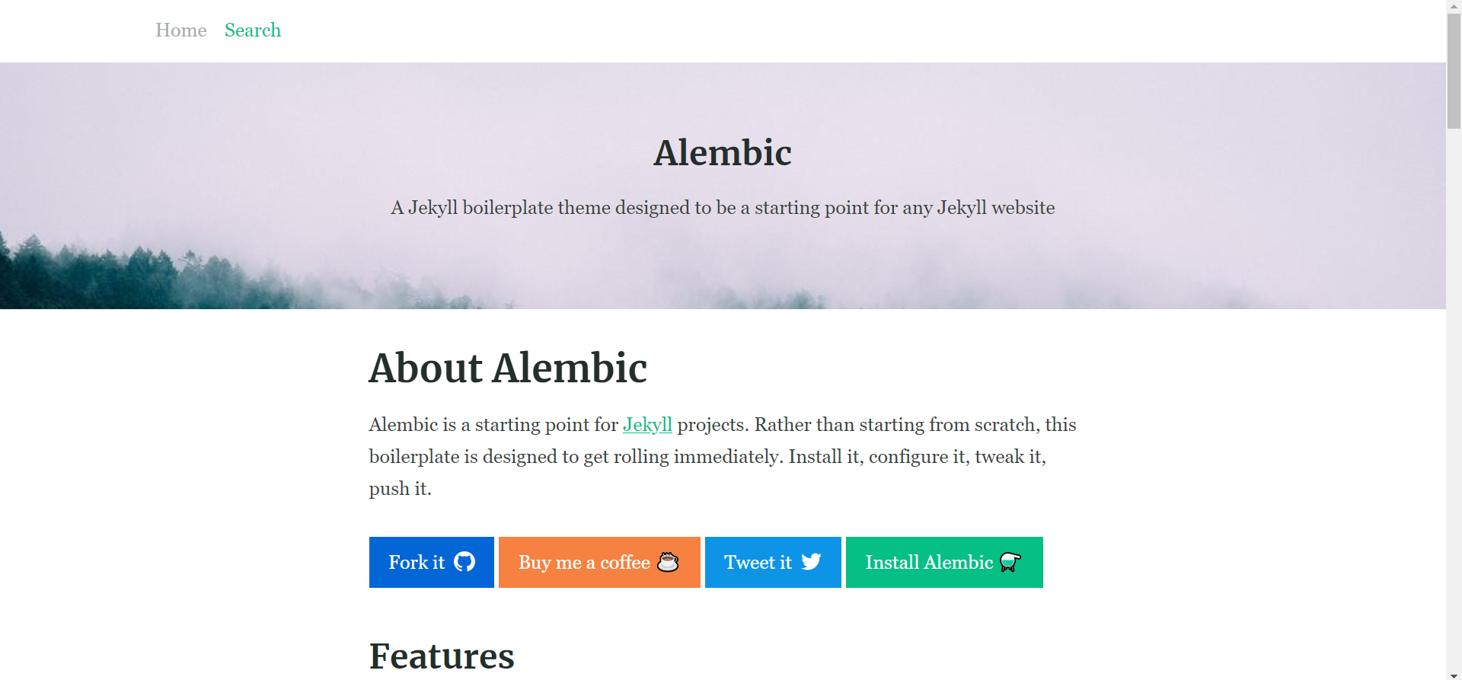
Our Website

Slide 6
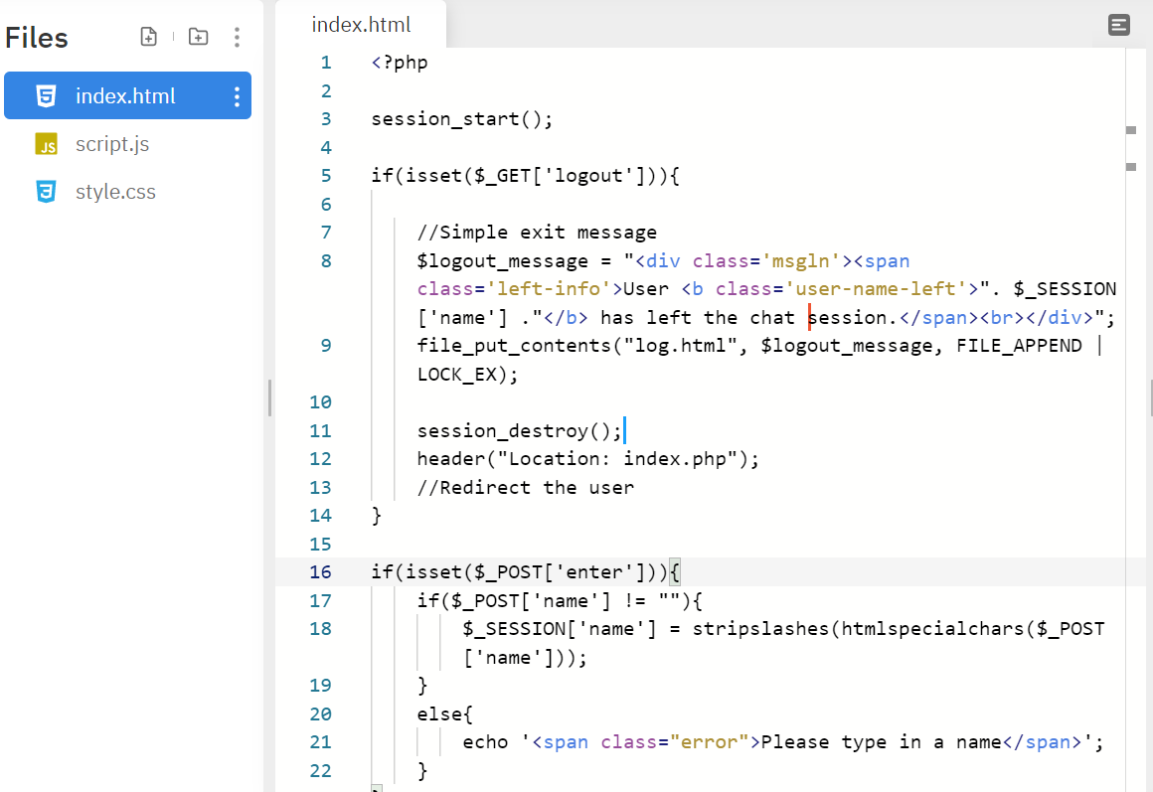
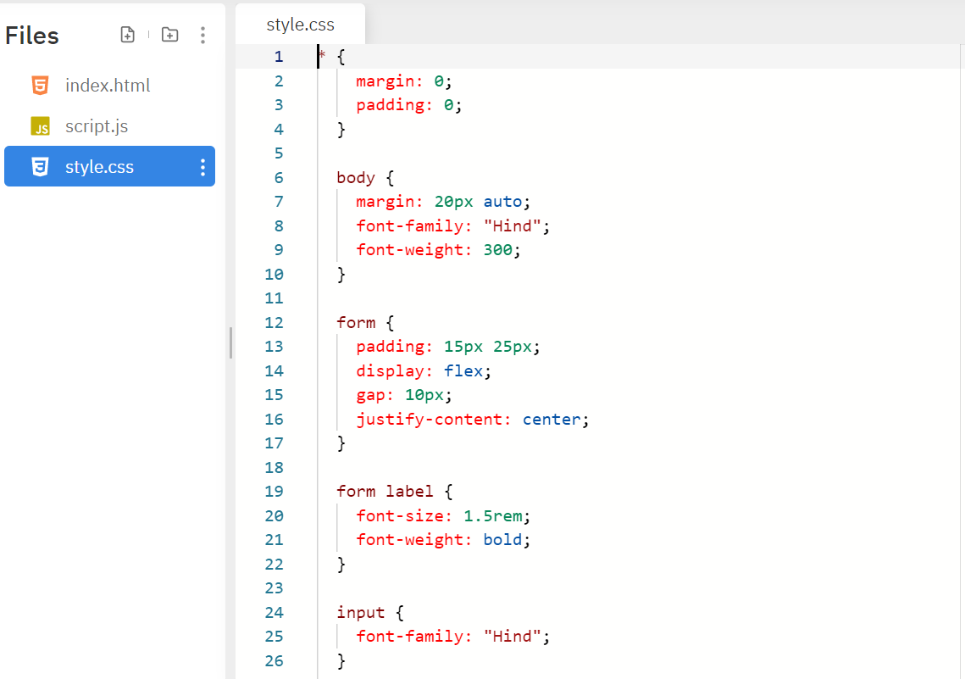
Chat Feature
Code for user login/logout & messaging.
Code for viewing the chat boxes.

Slide 7
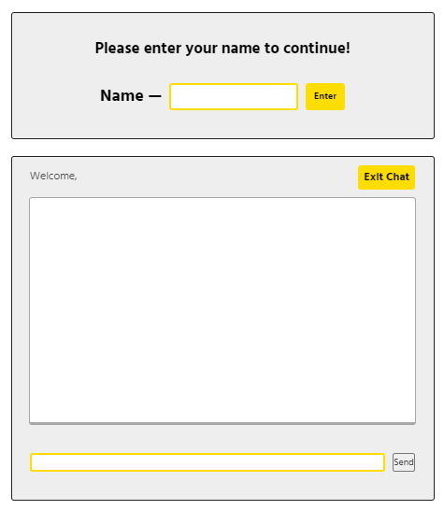
Chat Feature
Name inputs
Chat box
Notes:
Our chat feature contains an input where you can say your name. Then, you will be placed in a session with a random person. You can talk by typing in the box on the very bottom and clicking the send. By clicking Exit Chat you can exit the session. This allowed us to merge our goal of communication into the chat feature.

Slide 8


AR Feature
Anyone can meet new people in the comfort of their own homes by using our AR Bitmojis
If we plan to grow this software, we will work on getting real people talking through AR

Slide 9
Resources Used
PHP
HTML, CSS, and JavaScript (basic Web languages)
Coding Repository: Github
Repil.it
Web templates from Gabriel Nava & Jekyll
Workshops 1, 2 and 3
Bitmoji
echoAR
The Volunteers (especially David)

Slide 10
Thank You!!

